Slide 1
Strengthening blood Safety System in Georgia
Eteri Kipiani
National Center for Disease Control and Public Health
19 April, 2018

Slide 2
Outline
Current Status of BTS in Georgia
State Safe Blood Program
Main Challenges
Obligations under Safe Blood Strategy
Obligations under Association Agreement
Key Discrepancies between EU and National Regulations
Progress
EU Support (TAIEX, Twining)
Areas for Future Interventions
Notes:
Since 1997, a State Safe Blood Program operates in the country which is carried out by National Center for Disease Control and Public Health since 2011. The goal of the program is to prevent the spread of transfusion transmissible infections. Program provides the following activities:
- Screening of blood donors for Hepatitis B and C, HIV and Syphilis (using TPHA method) as well as blood group and rhesus determination.
- Provision of external quality control by Lugar Center of NCDC and Internationally accredited Reference laboratory. There are two mechanisms for external quality control. First is that state program requires from participating blood banks
to keep blood portions (aliquots) from each donation for two years and 5% of them are randomly selected and sent to Lugar Center for their retesting. Another option is that state program also requires from blood banks to contract internationally accredited reference laboratories and conduct proficiency testing.
- Popularization of regular unpaid blood donations and supporting campaigns including activities related to the World Blood Donor Day.
There are 12 blood establishments involved in the state program.
Since 2005, an electronic Donor Database has been launched which incorporates information on donors and donations from 16 blood banks.

Slide 3
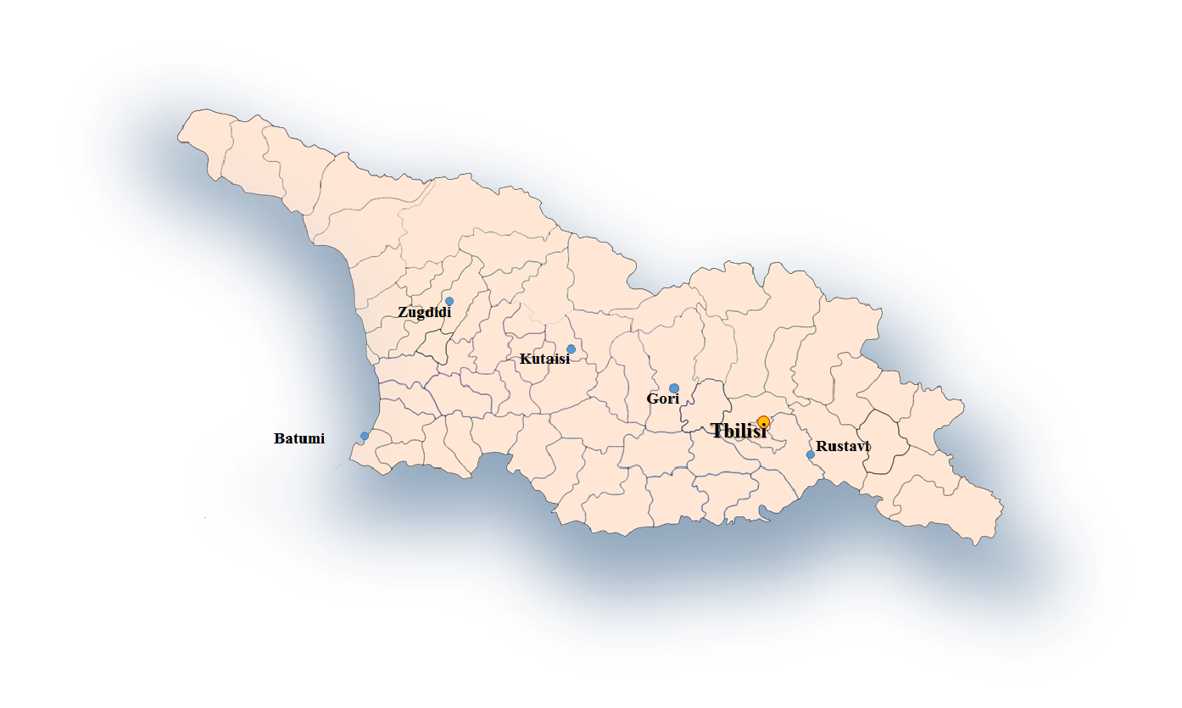


Current Status Distribution of Blood Banks in Georgia, 2018
22 blood establishments hold state license in blood production service, 15 blood banks out of them participate in the State Safe Blood Program (2 additional banks have been involved since 2018)
Samtredia
Participate in the state program
Blood banks involved since 2018
Do not participate in the state program
Notes:
Since Elimination Strategy has been approved in August of 2016, all current activities are related to the State Safe Blood Program:
In 2016 (9 month period) there were 52 850 donations performed by blood banks participating in the state program:
- Number of donors is 42940 and 718 anti HCV positive results were reported among them (1,7% of the total number of donors);
- Non-remunerated donation share is 31%.
Two cycles of external quality control have been conducted by Lugar center of NCDC and two cycles by international reference laboratory which is UK based organization RANDOX/RIQAS. That means that all participating blood banks are
involved in the RIQAS quality control system and all of them have submitted certificates of participation to NCDC in 2015. This process is continuing.
Number of informational/educational campaigns have been conducted on popularization of regular unpaid blood donations including activities related to June 14 - World Blood Donor Day.

Slide 4
State Safe Blood Program
Since 1997, a State Safe Blood Program operates in the country which aims at preventing the spread of transfusion transmissible infections, involves 15 blood establishments and provides:
Screening of blood donors for Hepatitis B and C, HIV by means of EIA method and Syphilis (using TPHA method) as well as blood group and rhesus determination
Provision of external quality control by Lugar Center of NCDC and Internationally accredited Reference laboratory
Popularization of regular unpaid blood donations
Since 2005, an Electronic Donor Database operates in the country where donation information, donor demographics and testing records are incorporated enabling traceability of transfusion transmissible infections according to the vein to vein principles. From 2017, all blood establishments are required to participate in the Donor Database

Slide 5
Statistical Data, 2015-2017
Based on analysis of statistical data from 2015-2017:
Paid donations prevail on the number of non-remunerated and family/replacement donations
Repeat donors constitute the majority of donations
Total number of donations has increased by 12% during last three years with slight increase (up to 5%) in the number of non-remunerated donations
Number and Percentage of donations by donor status, 2015-2017

Slide 6
Statistical Data, 2015-2017
A total of 225898 donors were tested within the three year period, of which 2529 (1,1%), 1837 (0,8%), 1117 (0.5%), and 211 (0.1%) were positive for HCV, HBV, syphilis and HCV, respectively. The prevalence of TTI screening positive cases in blood decreased steadily from 3,2% in 2015 to 2,1% in 2017.
Number and Percentage of donations by donor status, 2015-2017

Slide 7
Main Challenges
BTS organization
- Current blood transfusion service is decentralized in Georgia and no single management body has been identified so far which will be dedicated to provide surveillance over blood production and quality assurance at national level
- At present, there are 22 blood banks holding state license for production of blood and blood products, but only 15 of them are engaged in the State Safe Blood Program
Legal status of blood banks
- Approx. 90% of blood banks are profit-based organizations raising serious safety and ethical concerns
Licensing and accreditation
Current blood legislation is suboptimal and inconsistent with modern standards and EU directives
There are no effective mechanisms for license suspension or revocation for blood banks that violate even minimal licensing requirements and technical regulations
No accreditation system exists for blood establishments
Donor selection and recruitment
- Paid donations make up circa 70% of donor pool being a serious challenge in terms of blood safety

Slide 8
Main Challenges
Blood Collection
low standing inventory and limited product diversity
Laboratory Testing
exclusive serological testing, reliance on semi-automated and rapid platforms, deficient testing algorithms, lack of confirmatory testing etc.
Blood utilization and clinical practice
Lack of clinical guidelines for blood transfusion
No post-transfusion surveillance, no lookback, virtual absence of reporting to blood centers
Quality assurance
- Lack of standardization, SOPs for blood production procedures including donor selection, blood collection, preparation, testing, labeling, handling, storage, cold chain, usage etc.
- No effective external quality control mechanisms established for blood banks not participating in the State Safe Blood Program

Slide 9
Harmonization of National blood regulations with EU Directives and standards by the end of 2018
Establishment of the centralized TTI testing capacity by the end of 2020
Standardization of donor selection and blood testing processes in 2018
Obligations Under Association Agreement
Directive 2002/98/EC of the European Parliament and of the Council of 27 January 2003
Commission Directive 2004/33/EC of 22 March 2004 - implementing Directive 2002/98/EC of the European Parliament and of the Council
Obligations Under Safe Blood Strategy
Commission Directive 2005/61/EC of 30 September 2005 - implementing Directive 2002/98/EC of the European Parliament and of the Council
In 2016, a Strategic Plan for the Elimination of Hepatitis C Virus in Georgia has been adopted by the Resolution of the Government of Georgia which incorporates activities blood safety section and envisages:
In July 2016 ,the Association Agreement (AA) between the European Union and Georgia fully entered into force under which Georgia undertakes responsibility to approximate its regulations with the following directives:
Development and implementation of the quality control system according to GMP standards by 2018-2020
Transition from paid donation practice to a voluntary, non-remunerated donation system by the end of 2020
Commission Directive 2005/62/EC of 30 September 2005-implementing Directive 2002/98/EC of the European Parliament and of the Council

Slide 10
Current Blood Safety Regulations
National blood safety regulations that should be revised and approximated with EU directives include:
Law of Georgia “On Donation of Blood and Blood Components
Resolution Of the Government of Georgia № 385 approving Provisions on the Rules and Terms of Issue of a Medical Practice License and an In-patient Facility Permit
Decree of The Minister of Labour, Health and Social Affairs of Georgia №110/N, dated on 14th of March, 2001, on Transfusion Centers further development
Decree of the Minister №14/N on Approval of Rules for the Preparation, Reservation and Usage of blood and blood components
Decree of the Minister № 241/N on Determining of Blood and Blood Components Donation Contraindications
Resolution of the Government of Georgia № 74 approving Technical Regulations - Obligatory Normatives for Blood Transfusion Centers
Resolution of the Government of Georgia №539 on Approval of Technical Regulations for Blood Establishments

Slide 11
Key discrepancies between EU and current national regulations
EU Directives | National Regulations
Modern blood-transfusion practice should be founded on the principles of: Absence of profit on the part of the blood establishments Voluntary unpaid donor services | 86% of blood establishments are for-profit organizations Paid donors constitute a majority of donor pool, only 28% of total donations come from non-remunerated voluntary donors
Member States should organize inspection and control measures to be carried out by officials representing the competent authority | No inspection and control measures have been carried out from competent authority and no control system exists at central level
Blood establishments should establish and maintain quality systems including quality planning, quality control, quality assurance and quality improvement, taking into account the principles of good manufacturing practice as well as the EC conformity assessment system | No effective internal quality system exists at blood banks except of very week elements
An adequate system to ensure traceability of whole blood and blood components should be established | Although Donor Database enables registration and identification of blood donor and recipient but no consistent follow up and look back system exists to trace TTI infections in blood donations

Slide 12
Key discrepancies between EU and current national regulations
EU directives | National regulations
A set of organized surveillance procedures to collect and evaluated information of the adverse o unexpected events or reactions should be established in Member States | Although the donor data base enables blood banks and hospitals to register adverse events and reactions, no common system for notification and surveillance of adverse event s and reactions linked to the collection, processing, testing, storage and distribution of blood and blood components exists
Tests should be carried out in conformity with the latest scientific and technical procedures that reflect current best practice | Single serological testing is required by national regulations, no restriction has been placed on the usage of rapid tests, no nucleic acid testing of other high sensitive tests are required or applied
The competent authority may suspend or revoke the authorization or license of a blood establishment if inspection or control measures demonstrate that the blood bank does not comply with the requirement of the directives | License suspension or revocation mechanisms are too complicated and prolonged making almost impossible to revoke license in blood production service
Blood establishments shall ensure that there are evaluation procedures in place for all donors of blood and blood components and that the criteria for donation defined by directives are met | Permanent and temporary deferral criteria are defined by the Minister’s decree, but no unified Donor Questionnaire exists that would exempt unsafe donors before infection testing

Slide 13
Progress
A technical workgroup has been established by the Minister’s Decree #01-127/O, dated on June 07, 2017, on “Creation of a Working Group in order to Ensure Safety of Blood Production and Transfusion in Georgia”
Modernization of the Unified Blood Donor Electronic Database has been finalized through the addition of an advanced modules to the existing core variables
Training courses for hospital and blood bank personnel have been conducted in data entry and operation of the Donor Database (21 training courses, 425 trainees).
Since July 2017, participation in the donor database became mandatory for all blood banks irrespective of their involvement in the State Safe Blood Program and for all hospitals performing blood transfusion
Linkage between Donor Database and hepatitis C screening modules has been established

Slide 14
Progress
Financial Stimulation of non-remunerated donations has been established within the State Safe Blood Program
Confirmatory testing of HCV screening positive cases was introduced within the Hepatitis C Management Program that eliminated financial barrier to in depth diagnostic services
Since 2018, blood banks transfer hepatitis C screening-positive samples to the Lugar Center for Cor-Ag confirmatory testing
For the first time, mandatory voluntary donations and mandatory nucleic acid testing was introduced for blood donors with high behavioral risk (msm, persons with unprotected sexual contacts or multiple partners)
KAP survey on the voluntary donor motivation factors have been conducted findings of which will serve as a bases for future communication interventions

Slide 15

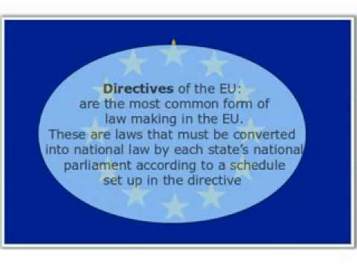
Progress EU Technical Assistance Tools
In December 2017, NCDC submitted Strategic TAIEX and Twinning Projects to European Commission aiming at approximation of national blood safety regulations to EU directives.
TAIEX project was approved
Twinning project was included into the priorities short list
DIRECTIVE 2002/98/EC OF THE EUROPEAN PARLIAMENT AND OF THE COUNCIL of 27 January 2003 setting standards of quality and safety for the collection, testing, processing, storage and distribution of human blood and blood componentsand amending Directive 2001/83/EC
COMMISSION DIRECTIVE 2004/33/EC of 22 March 2004
implementing Directive 2002/98/EC of the European Parliament and of the Council as regards certain technical requirements for blood and blood components
COMMISSION DIRECTIVE 2005/61/EC of 30 September 2005
implementing Directive 2002/98/EC of the European Parliament and of the Council as regards traceability requirements and notification of serious adverse reactions and events
COMMISSION DIRECTIVE 2005/62/EC of 30 September 2005
implementing Directive 2002/98/EC of the European Parliament and of the Council as regards Community standards and specifications relating to a quality system for blood establishments

Slide 16
Areas for Future Intervention
Still need to be done
Finalize building of external quality control system and involve all blood banks
Revise and approximate national blood safety regulations with EU directives
Finalize amendments to licensing requirements and submit for endorsement
Prepare for expert mission within TAIEX tool
Short tem objectives
Implement necessary activities to introduce NAT piloting in 2019 (including NAT apparatus and trainings)
Increase voluntary unpaid repeat donations
Conduct active communication campaign to raise population awareness on voluntary regular blood donations

Slide 17
Thank you for your attention!

